Slide 1
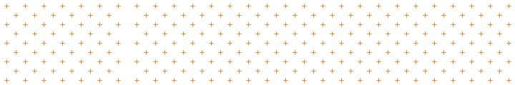
Fundamentals of Human-Centered Design
Day 1
Patty Beirne Patricia.Beirne@opm.gov
Corinne Vizzacchero Corinne.Vizzacchero@opm.gov

Slide 2

Welcome!
Thank you so much for joining us for the Fundamentals of Human-Centered Design.
We will focus on:
Breaking down complex problems to understand their root causes
How root causes impact the people we serve
Why human behavior might inform potential solutions
The use of rapid prototyping to learn about and develop potential solutions to complex challenges

Slide 3
The Lab at The Office of Personnel Management
Introductions & HCD Overview
The Lab at OPM (The Lab) is a that fosters innovation through human-centered design. Our purpose is to teach human-centered design across the Federal Government and help deliver innovative solutions to address complex public and cross-sector challenges.
https://lab.opm.gov

Slide 4
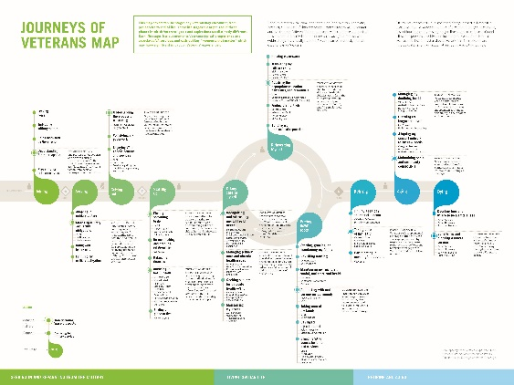
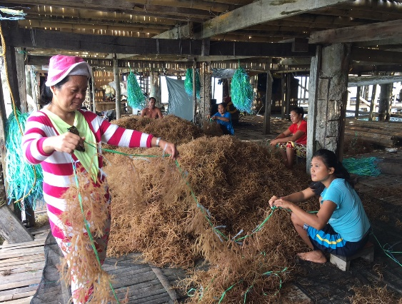

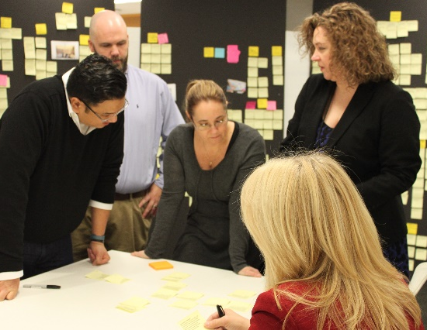

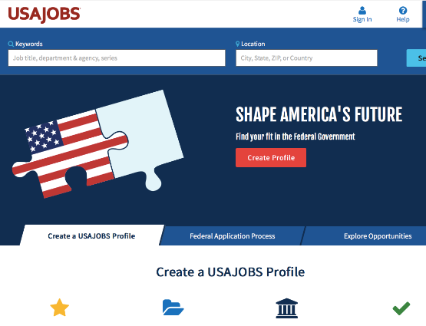
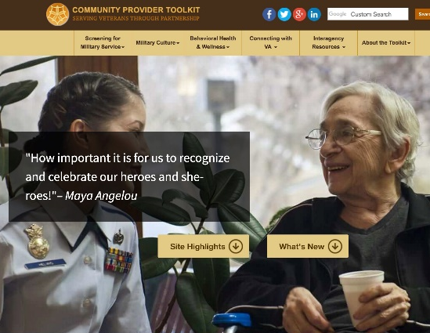
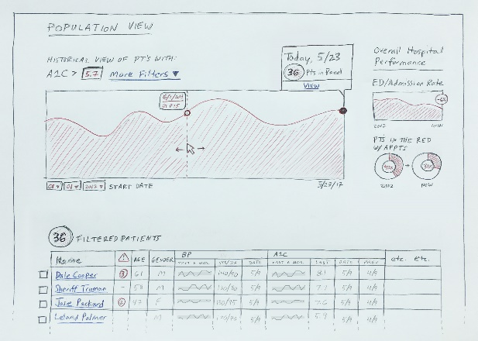
Introductions & HCD Overview
The Lab’s Portfolio
Our work ranges from pure stakeholder-insight and discovery efforts to full design and piloting projects.
We’ve done experience mapping with VA, form design with USDA, full-stack development for USAJobs, etc.

Slide 5
Spirit of this workshop
This workshop is an introduction to HCD. Becoming proficient takes longer than three days.
You will need to fully participate and minimize work distractions.
We believe that collaboration is a survival strategy. This workshop hinges on your ability to collaborate with others.
Allow yourself to look beyond what you know and what you are familiar with. Take some risks. Nobody will judge you for it.
All opinions are welcomed and appreciated.
Notes:
An access check-in allows people to share any access needs they might have, if they feel comfortable.
For example, “I may need to step out of the room from time to time” or “I will often go to the back of the room to do stretches as I listen” or “I need people to speak up when they speak.”
This is a useful way to value access and destigmatize it in an ableist culture that hides, shames and individualizes access. This is also a useful way to remind people that everyone has access needs, not only people with disabilities. It is important to note that many people will not share their access needs and that is okay. This is especially true if people do not have anyone in the room with whom they have access intimacy. We don’t want to replicate a culture of ableism and forced intimacy that disabled people have to endure every day. Never force anyone to share their access needs.

Slide 6
3 days, all day
Course
Overview
Develop an understanding of the mindsets, methods and tools in the practice of Human-Centered Design (HCD).
Explore how to apply HCD to the challenges you may find at work.
Improve collaboration and co-creation skills.
Learn to design within constraints and to accept constraints as a key part of the design process.

Slide 7
Day 1
Today’s
Agenda
Introductions: The Lab + Each Other
Innovation + Design: Human-Centered Design
Frame: Importance and Examples
Explore: Design Ethnography + Planning Research
Lunch: 12:00-1:00
Explore: Conducting Fieldwork
Explore: Regroup and Reflect
Wrap up: 4:30

Slide 8
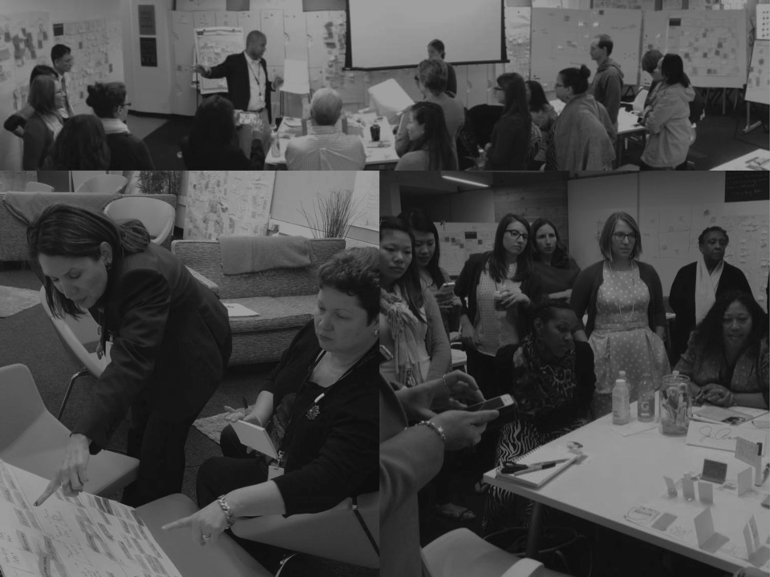
Who are we?
Let’s introduce ourselves.
Notes:
Possible activity, after intros: turn to person next to you and share a time you changed something from existing to preferred; pin on wall [?]

Slide 9
What is innovation?
Design + Innovation

Slide 10
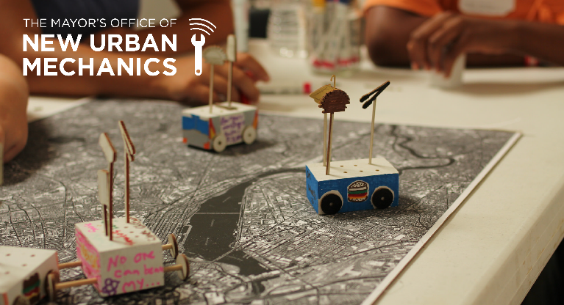

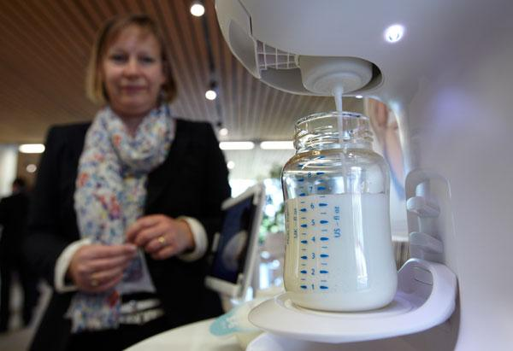
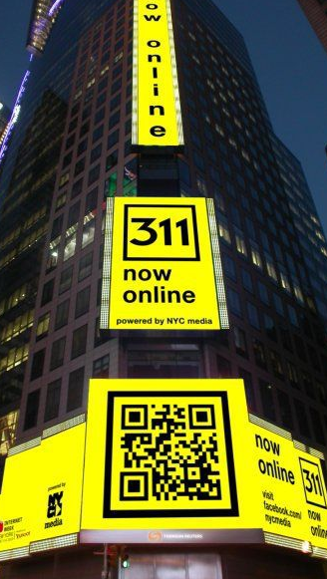
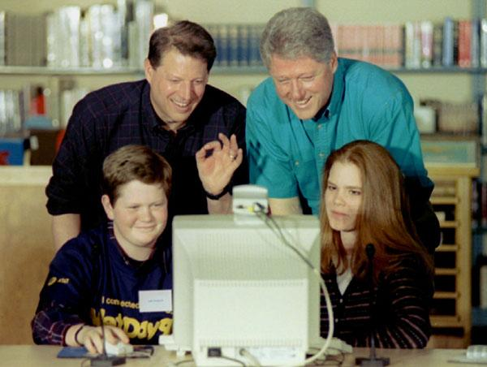

Innovation in government
Introductions & HCD Overview
Although it arose largely from private industry, HCD is uniquely suited to the work of government, where serving people’s needs is both good policy and sound strategy.
Government has contributed to many critical innovations.

Slide 11
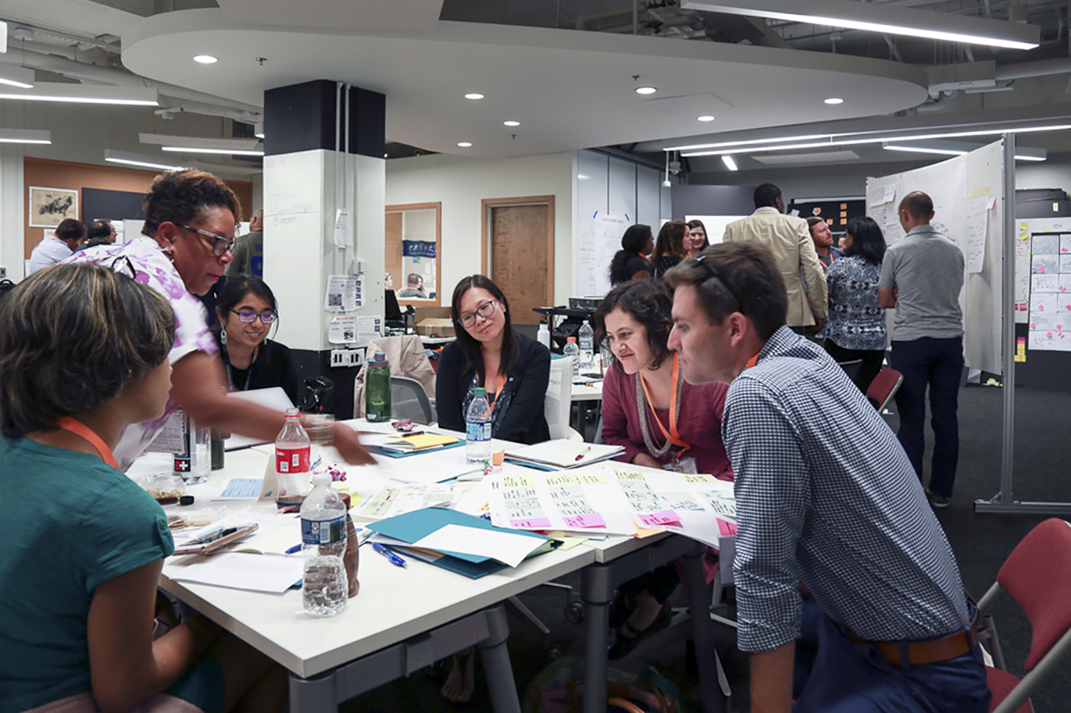

Slide 12
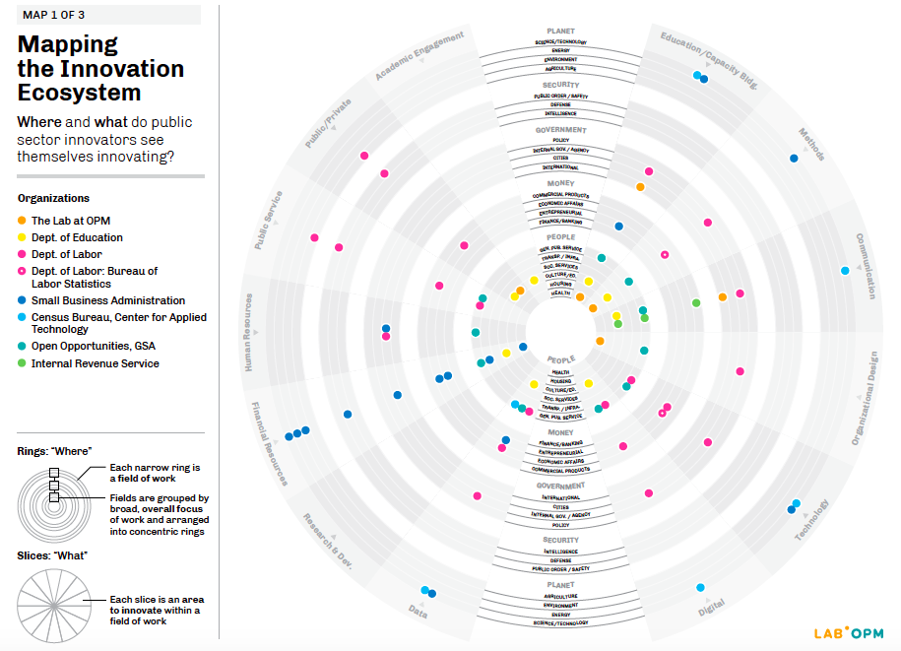

Slide 13
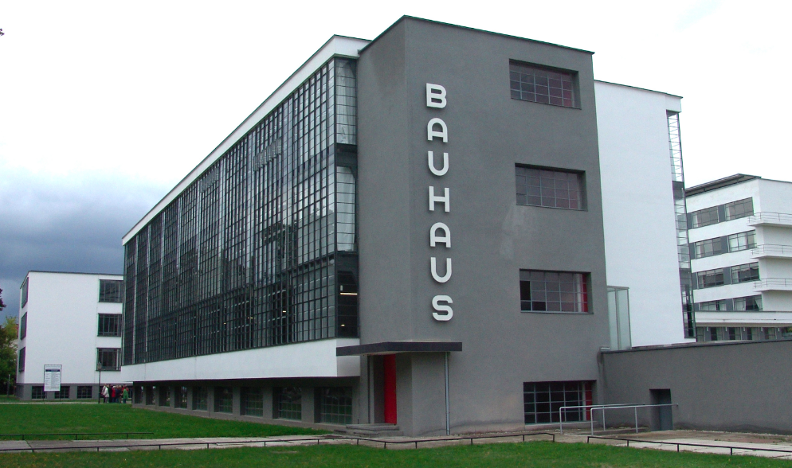
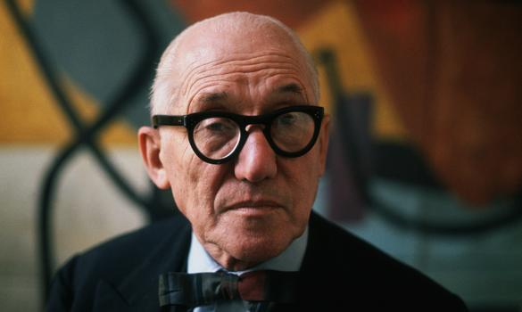
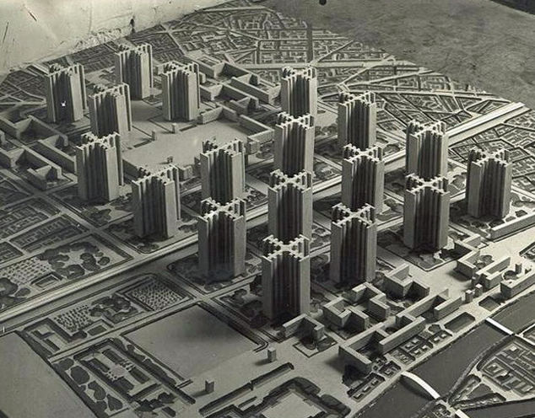
Design + Innovation
The origins of
stakeholder discovery and design
In the ‘30s, ‘40s, and ‘50s…
Modernist architects and industrial designers employed “top-down” approaches to designing, following what they saw as universal rules of form and function.

Slide 14
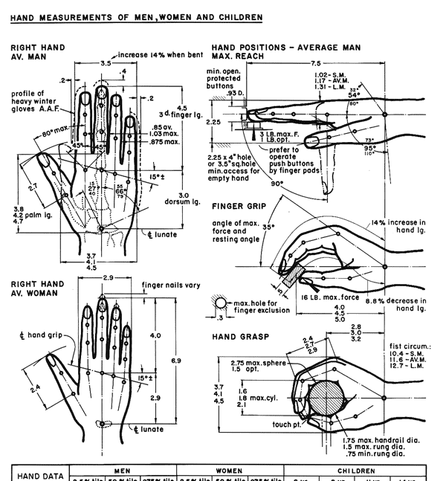
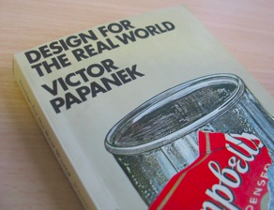
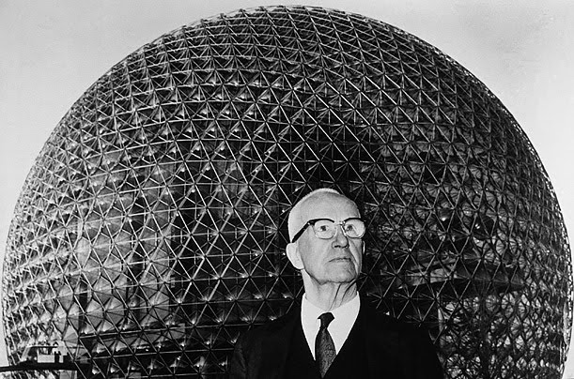
Design + Innovation
The origins of
stakeholder discovery and design
In the ‘60s, ‘70s, and ‘80s…
Computer scientists and management experts formalized processes of designing for particular situations and needs through “diagnosis followed by prescription.”

Slide 15

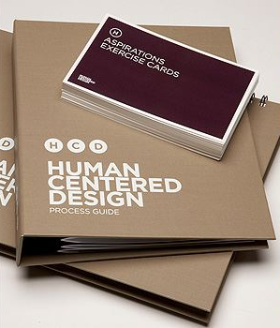
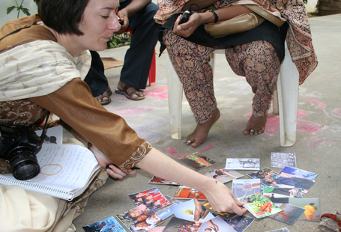
Design + Innovation
The origins of
stakeholder discovery and design
In the ‘90s, ‘00s, and ‘10s…
Restless designers and social innovators have adapted immersive and participatory methods for designing with people, integrating qualitative social-research practices.

Slide 16
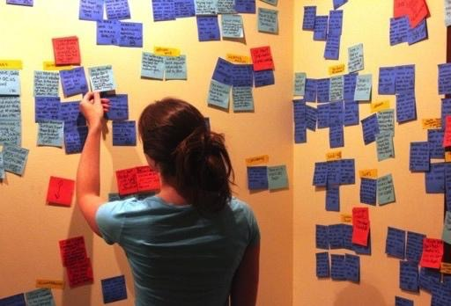
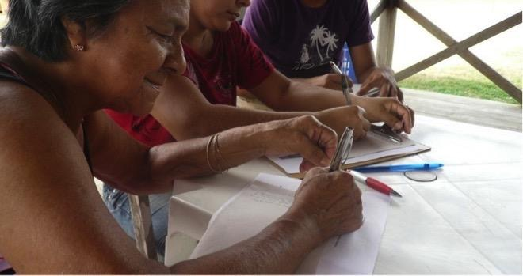
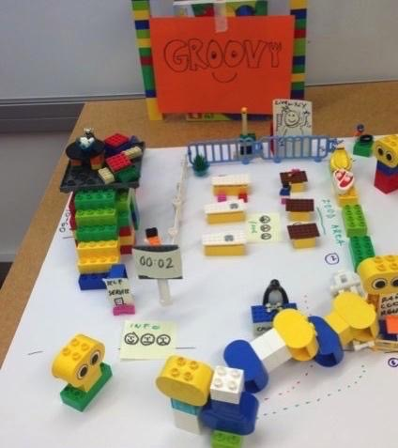
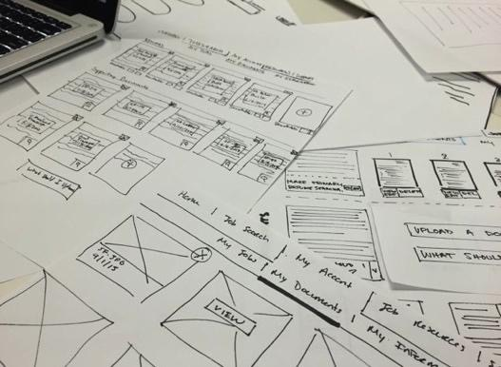
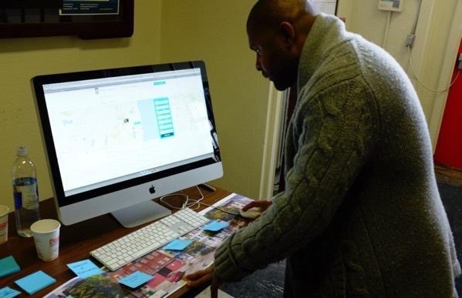
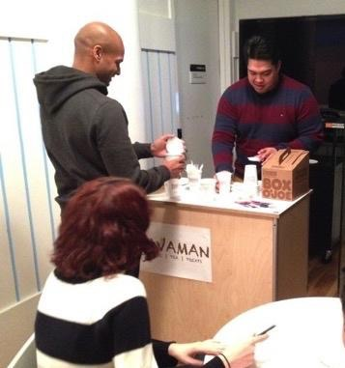
A process greater than the sum of its products
Design + Innovation
HCD offers a (relatively) new orientation towards design characterized less by its products than its processes. It’s not about predefined material outcomes. It is about solving problems, creating opportunities, and meeting needs.

Slide 17
An integrative discipline, a connective methodology
Design + Innovation
HCD draws on familiar design disciplines:
Graphic Design
Industrial/Product Design
Digital/Web Design
Fashion Design
Interior/Landscape Design
Architecture
Etc.
And incorporates other methodologies:
Anthropology & Sociology
Cognitive & Computer Science
Behavioral Economics
Ergonomics/Human Factors
Participatory Design
Service/Experience Design
Interface/Interaction Design
Brand/Business Strategy
Etc.

Slide 18
Design + Innovation
Distinguishing HCD
HCD is a close cousin to some other innovative practices:
Design Thinking
Design Sprints
Agile Development
Lean Manufacturing
Scenario Planning
Adaptive Leadership
Six Sigma, Etc.
But these are more specific tools and tactics developed by organizations for (or from) particular applications in their work. HCD is a complimentary discipline which often includes, but is not wholly defined by, these sorts of methods and mindsets.

Slide 19
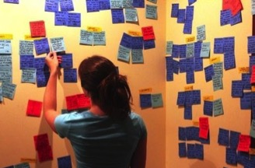
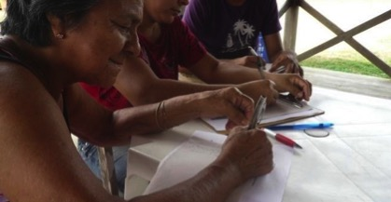
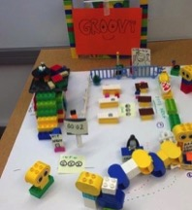
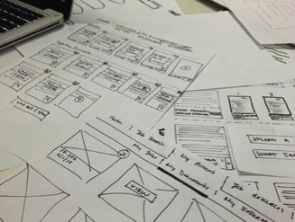
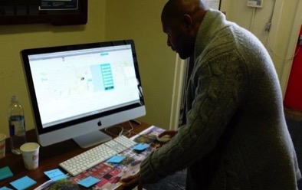
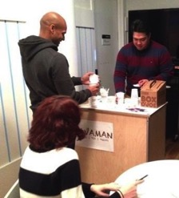
Design + Innovation
What does human-centered design look like?

Slide 20
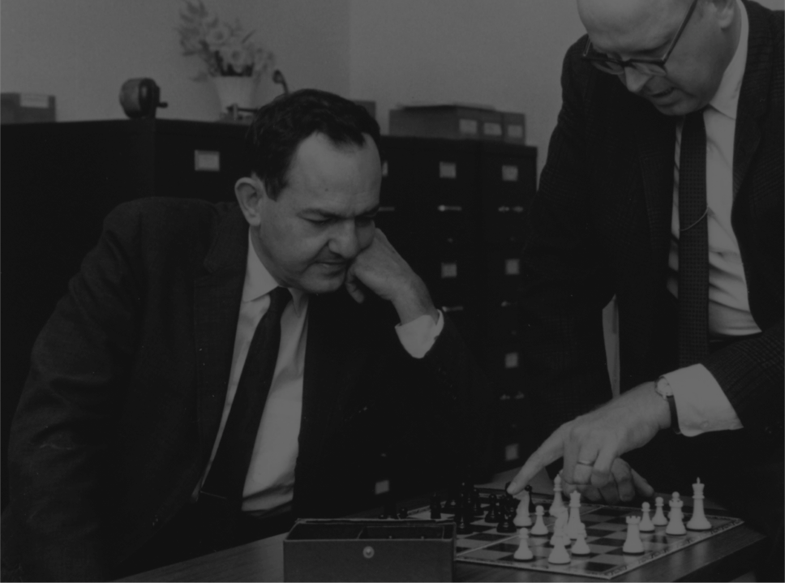
Everyone designs who devises courses of action aimed at changing existing situations into preferred ones.
“
Design + Innovation
—
Herbert Simon
Economist, Psychologist and Design Theorist

Slide 21
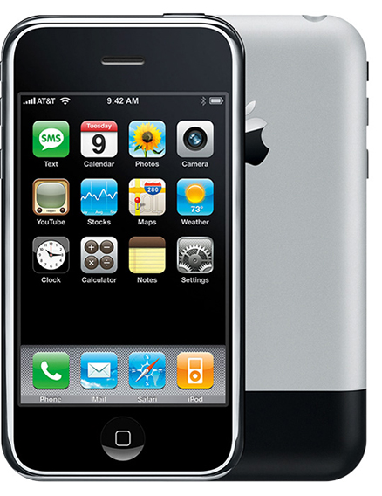
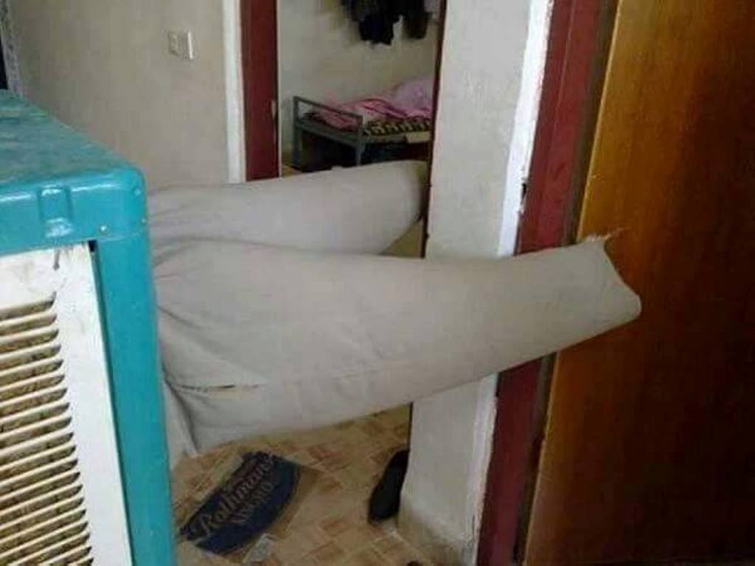
Notes:
original iPhone 2007 / air conditioner + pants

Slide 22
Existing to preferred solutions

Slide 23
design = progress

Slide 24
Defining Human-Centered Design
The discipline of navigating complex problems and creatively designing effective solutions to meet people’s real needs.
Design + Innovation

Slide 25
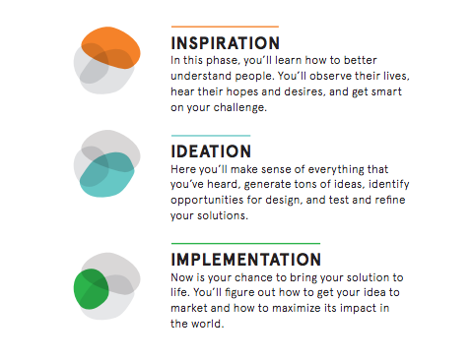
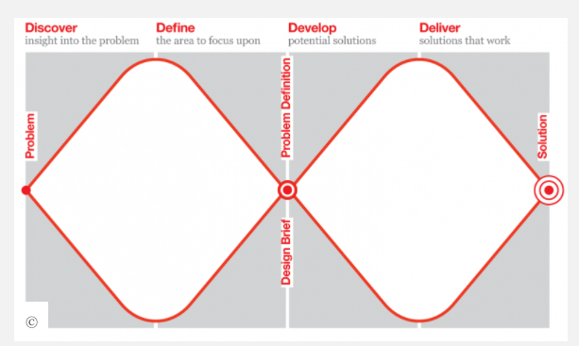
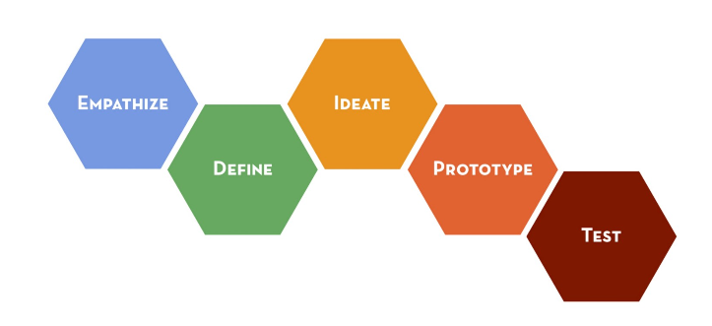
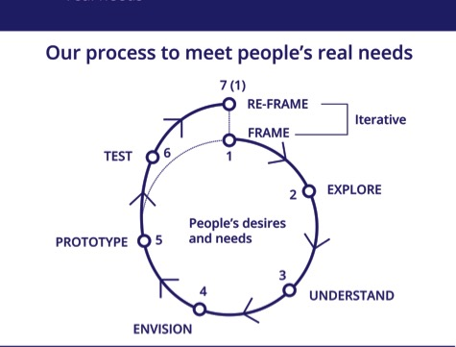
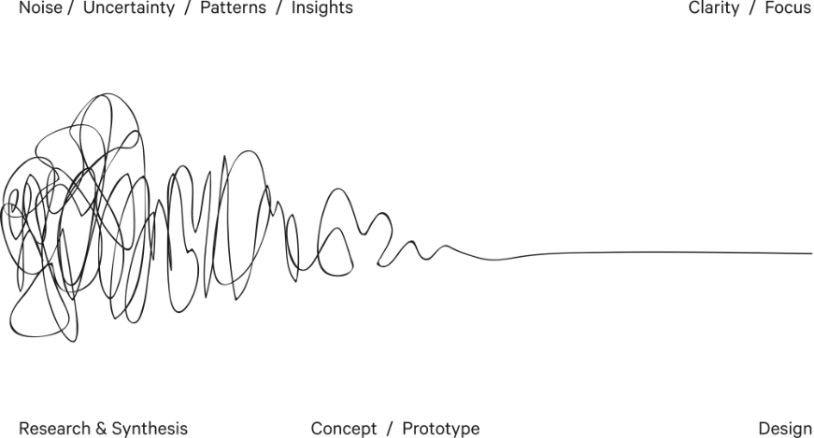
Notes:
https://designfuckingthinking.tumblr.com/

Slide 26
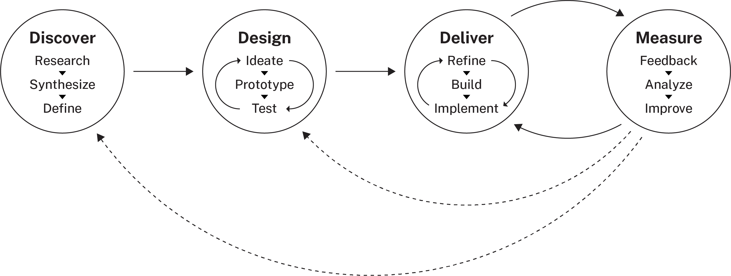
Design + Innovation
Notes:
Essentially:
Starts with research re: user needs
Not linear Diverge + converge Generative, constructive Iterative

Slide 27
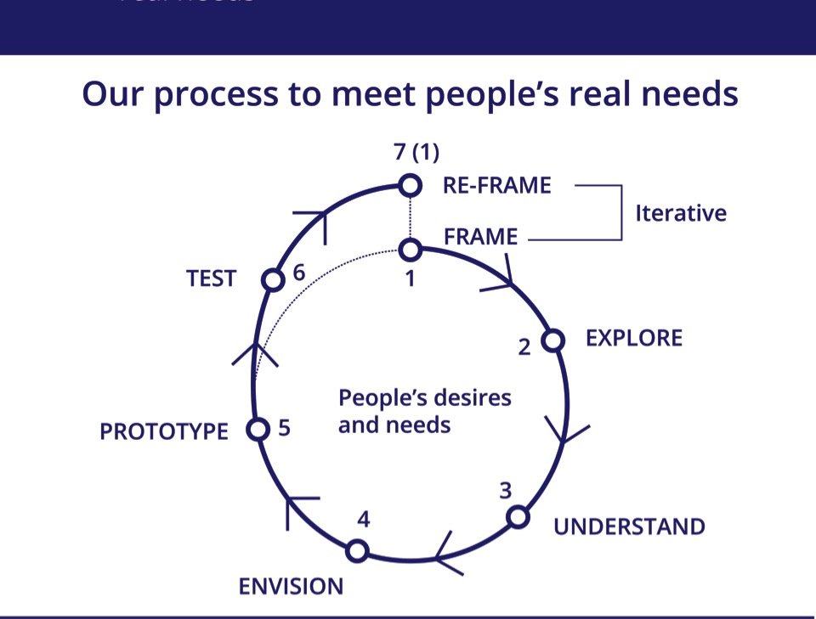

Slide 28
Time for an exercise!
Problem framing

Slide 29
Design a flower vase.
Design a way to enjoy flowers in your home.
Problem framing

Slide 30
Design a flower vase.
Design… a way to enjoy flowers in your home.
Problem framing

Slide 31

“
The mere formulation of a problem is far more often essential than its solution... To raise new questions, new possibilities, to regard old problems from a new angle requires creative imagination and marks real advances in science... [and design!]
—
Albert Einstein

Slide 32
Problem framing
Framing a design problem is a preliminary part of developing solutions.
Problem framing

Slide 33
Problem framing
It is a point of departure that helps measure progress in terms of how the initial framing evolves to more accurate framings.
Problem framing

Slide 34
Problem framing
Why do problem framing?
Breakthrough innovation is often the result of simply seeing old problems and opportunities in new ways.
Effective problem framing and reframing allows us to:
Avoid wasting resources on solving the wrong problems
Expand the range of possible solutions to any given problem
Maximize creative leverage and innovative potential of HCD

Slide 35
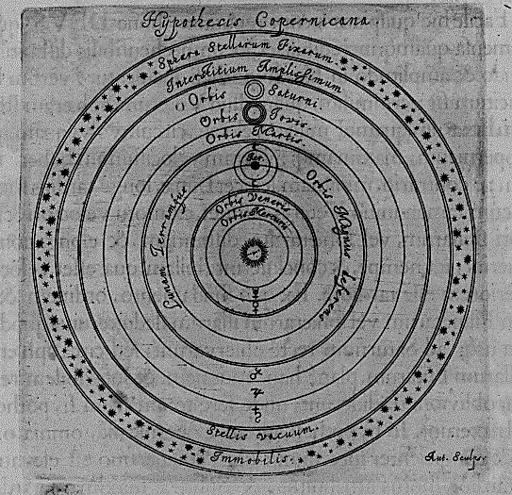
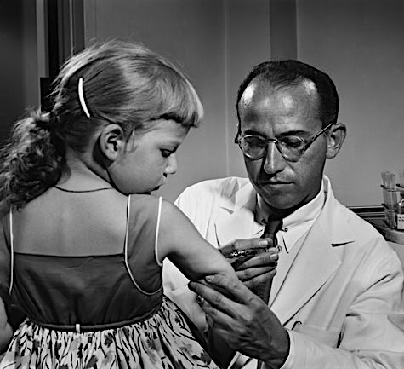

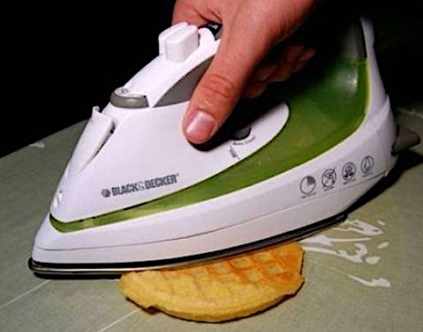
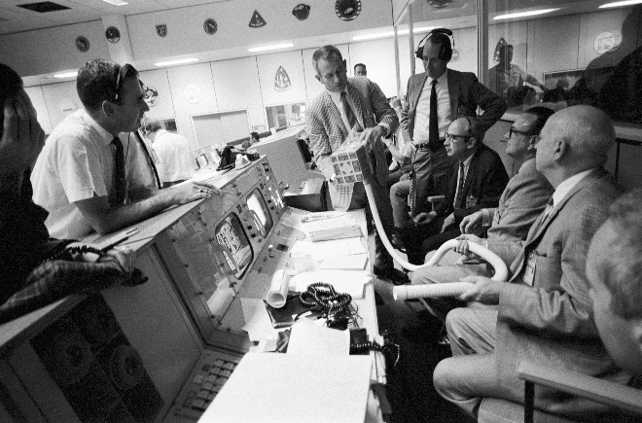
Problem framing
Classic reframes
Give me 5 plus 5→ What two numbers add up to 10?
Faster horses? Better cars? Or mobility alternatives?

Slide 36

36
Notes:
Main Talking Points:
x
Example:
Activity Instructions:
x
Activity Management:
x
Reflection:
x
Transition:

Slide 37

37

Slide 38

38

Slide 39
Our challenge* *a task or situation that tests someone’s abilities
Your challenge for these three days will be:
To analyze the current experience of base staff during lunchtime
To envision how staff’s lunchtime experience could change or transform in the future

Slide 40
Problem framing
Facts
predetermined data and information points accepted as reliable, such as previous research, published information, specialized literature, etc.
Assumptions
pre-assumed positions (in this context, they are not considered negative by default); not fully sanctioned as reliable but with direct potential to impact the problem space

Slide 41
Notes:
NOTE: Omit activity if behind on time? (Per Corinne’s deck, omitted in Sept 2019, NYC.) FACILITATOR: Peter

Slide 42
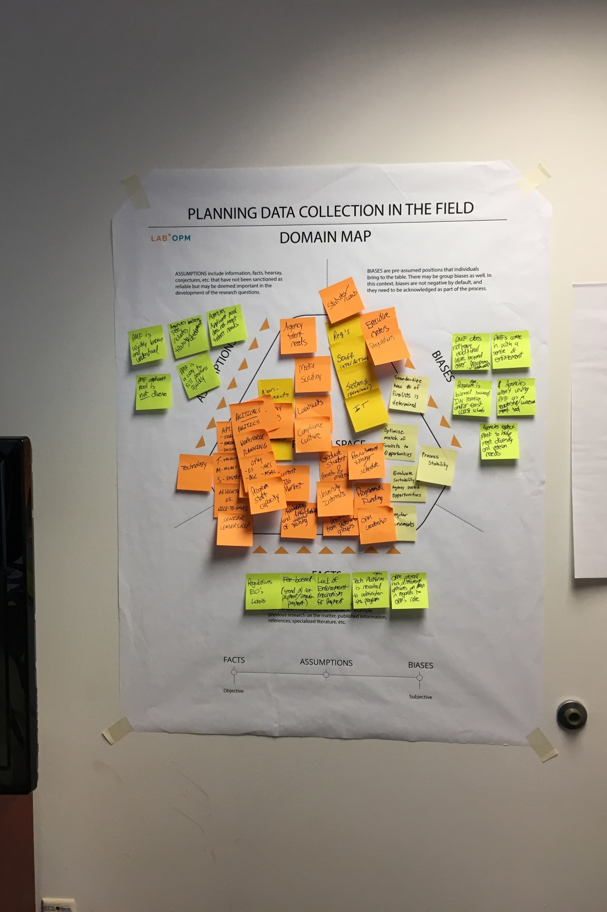
Notes:
NOTE: Omit activity if behind on time? (Per Corinne’s deck, omitted in Sept 2019, NYC.) FACILITATOR: Peter

Slide 43
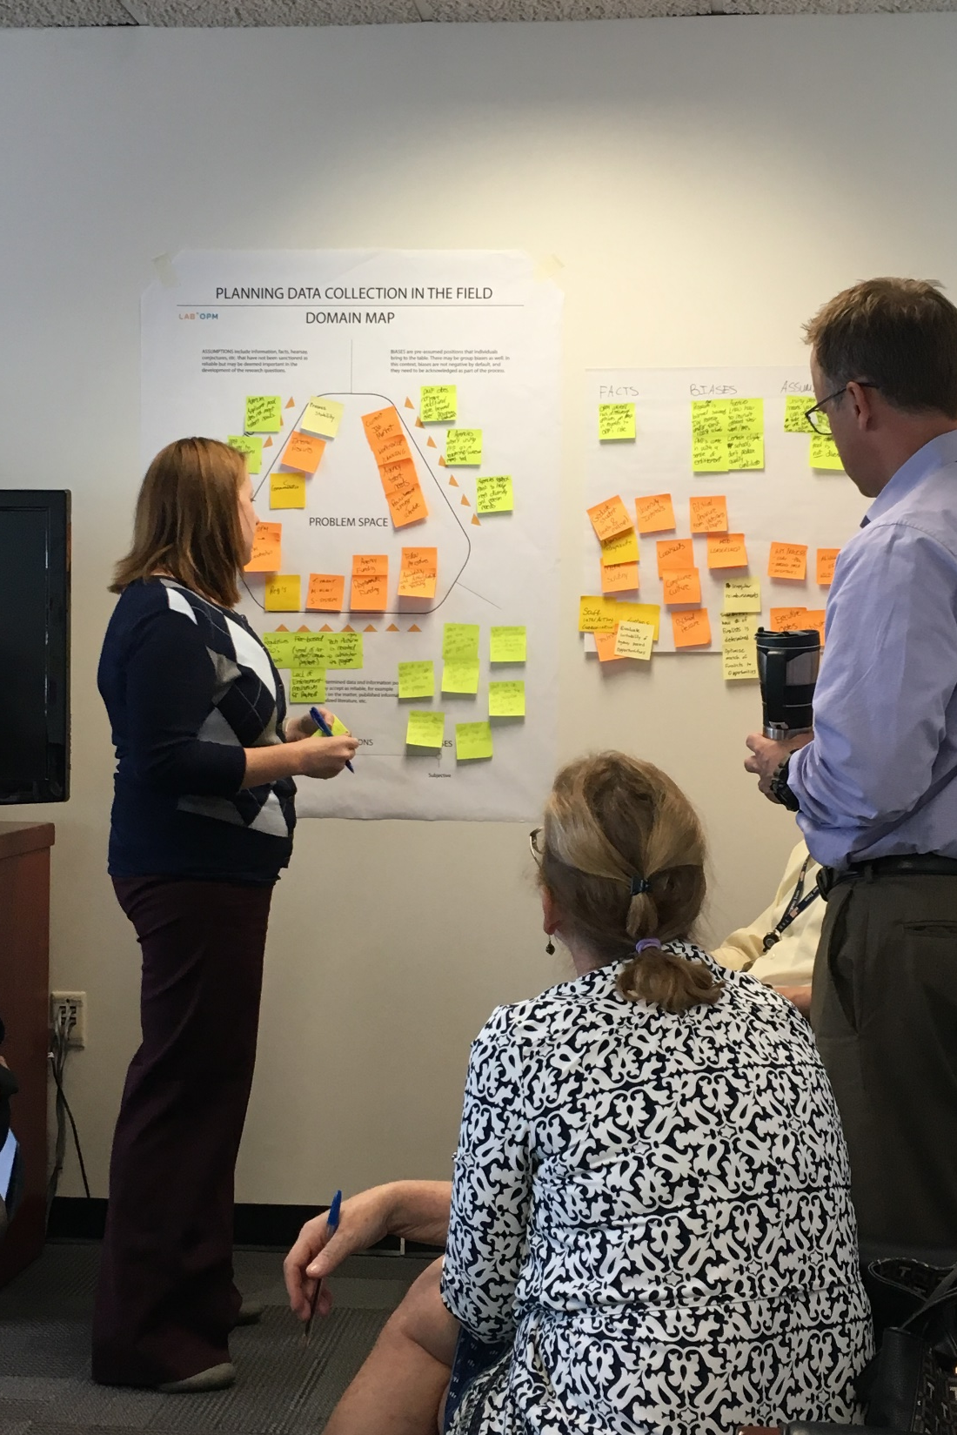
Notes:
NOTE: Omit activity if behind on time? (Per Corinne’s deck, omitted in Sept 2019, NYC.) FACILITATOR: Peter

Slide 44

Explore:
Design ethnography

Slide 46
How do we learn about our stakeholders?
Design Ethnography
QUANTITATIVE DATA
Deals with numbers
QUALITATIVE DATA
Deals with descriptions
The age of a painting is quantitative data.
The pleasure or displeasure it provokes in the viewer is qualitative data.

Slide 47

TWITTER MAP OF HURRICANE SANDY AFTERMATH

Slide 48
Defining Design ethnography
Design ethnography is best described as making the strange familiar and the familiar strange.
Design Ethnography

Slide 49
Defining Design ethnography
Design ethnography is best described as making the strange familiar and the familiar strange.
Design Ethnography
MAKING THE STRANGE FAMILIAR implies accepting the unknown, the unusual, and the unexpected, as the new normal
MAKING THE FAMILIAR STRANGE means developing a renewed curiosity for what you know, giving it a new value.

Slide 50

“What people say and what people do and what they say they do are entirely different things.”
“
Design Ethnography
—
Margaret Mead
Anthropologist

Slide 51
“What people say and what people do and what they say they do are entirely different things.”
“
[…and not to mention what we think people do…]
Design Ethnography
—
Margaret Mead
Anthropologist

Slide 52

Design Ethnography

Slide 53

Design Ethnography:
Interviewing

Slide 54


Design Ethnography:
Observation
Design Ethnography:
Observation

Slide 55

Design Ethnography:
Contextual Inquiry

Slide 56


Design Ethnography:
Walk-A-Mile
Design Ethnography:
Walk-A-Mile

Slide 57
Defining data collection
Structured approaches are planned beforehand (pre-arranged questions) Unstructured approaches are ad-hoc (within the given area of focus) Open approaches are planned but open to modification (the researcher decides on the spot)
Design Ethnography

Slide 58
Interviewing Tips
Design Ethnography
Interviewee must be provided a platform to tell their story
Ask questions you believe you know the answer to and then ask “Why”
Ask open-ended questions
Avoid leading or loaded questions
Give room between questions
Repeat a key word
Use inclusive language

Slide 59


Slide 60
Our challenge* *a task or situation that tests someone’s abilities
Your challenge for these three days will be:
To analyze the current experience of base staff during lunchtime
To envision how staff’s lunchtime experience could change or transform in the future

Slide 61
Explore:
Conducting fieldwork

Slide 62

Understand:
Packaging and handling data

Slide 64


Slide 65

“I don’t know what keywords to use since there are so many.”
“Applying for Federal jobs is going to be a long drawn out process and you will have your heart broken at the end of it.”
"Usually when I hear I didn't make the list for consideration I don't care anymore. I tried that, you can't get in touch with anyone for an explanation. When you get through to someone they don't have answers for you”
“In USAJOBS a lot of language is extremely confusing, the structure of job announcements is not user friendly, interaction with our agency is clunky and we lose applicants along the way.”
“If you have questions about USAJOBS you have to figure it out on your own. I check with social media to get an understanding of the website.”

Slide 66
Packaging and handling data
Understand
On yellow post-its write out your data points- one per post-it (quotes and/or observations)
Review photos, select observations, and write a keyword or brief description of the selections.

Slide 67

Thank You!

